Slide 1


Slide 2

Strengthening THE FUTURE – 4th – 7th JUNE – Mexico 2014
NUESTRA HISTORIA
Hoy celebramos 20 años de Asutil
Para poder proyectarnos hacia el futuro es importante conocer nuestro pasado y quienes hicieron posible esta realidad.
BRASIF, H. STERN, INTERBAIRES, LONDON SUPPLY, FUNDACION DEL NIÑO, AEROLIBRES ECUATORIANA, ZEINAL HNOS y NEUTRAL

Slide 3
Strengthening THE FUTURE – 4th – 7th JUNE – Mexico 2014
NUESTROS FUNDADORES
SANTOS DE ARAUJO FAGUNDEZ
VICTOR HUGO BONNET
ARIEL SANCHEZ
DANIEL POMIES
RUBENS HORWATITSCH
ADOLFO PERTIERRA MENENDEZ
CARMEN MAYA

Slide 4
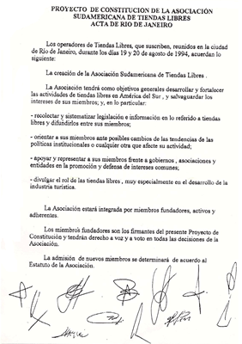
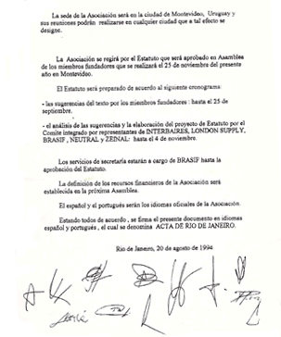
Strengthening THE FUTURE – 4th – 7th JUNE – Mexico 2014
Acta de Rio - 1994

Slide 5
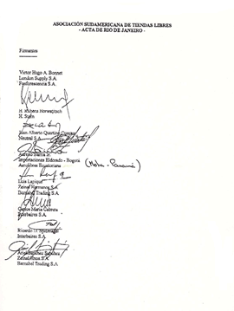
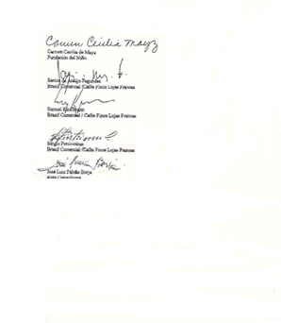
Strengthening THE FUTURE – 4th – 7th JUNE – Mexico 2014
Acta de Rio - 1994

Slide 6
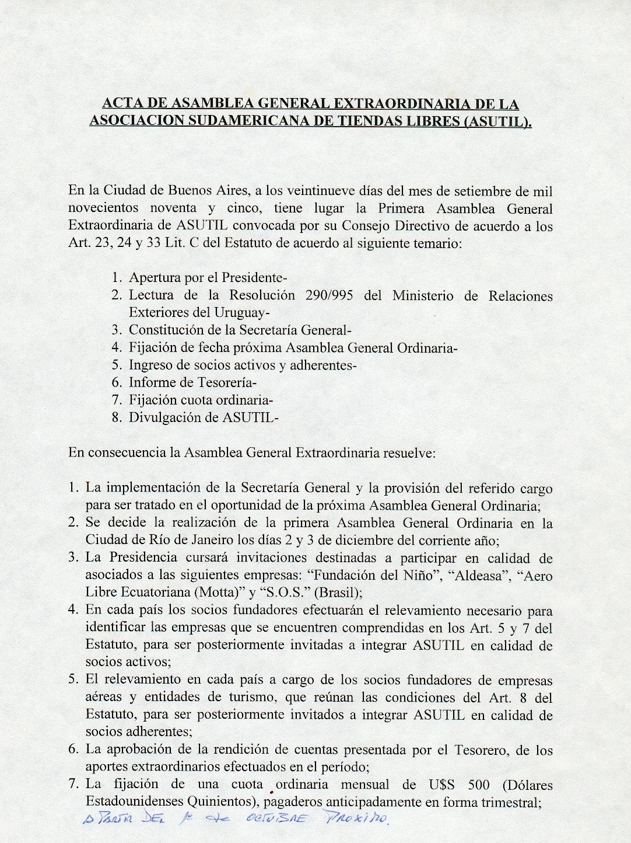
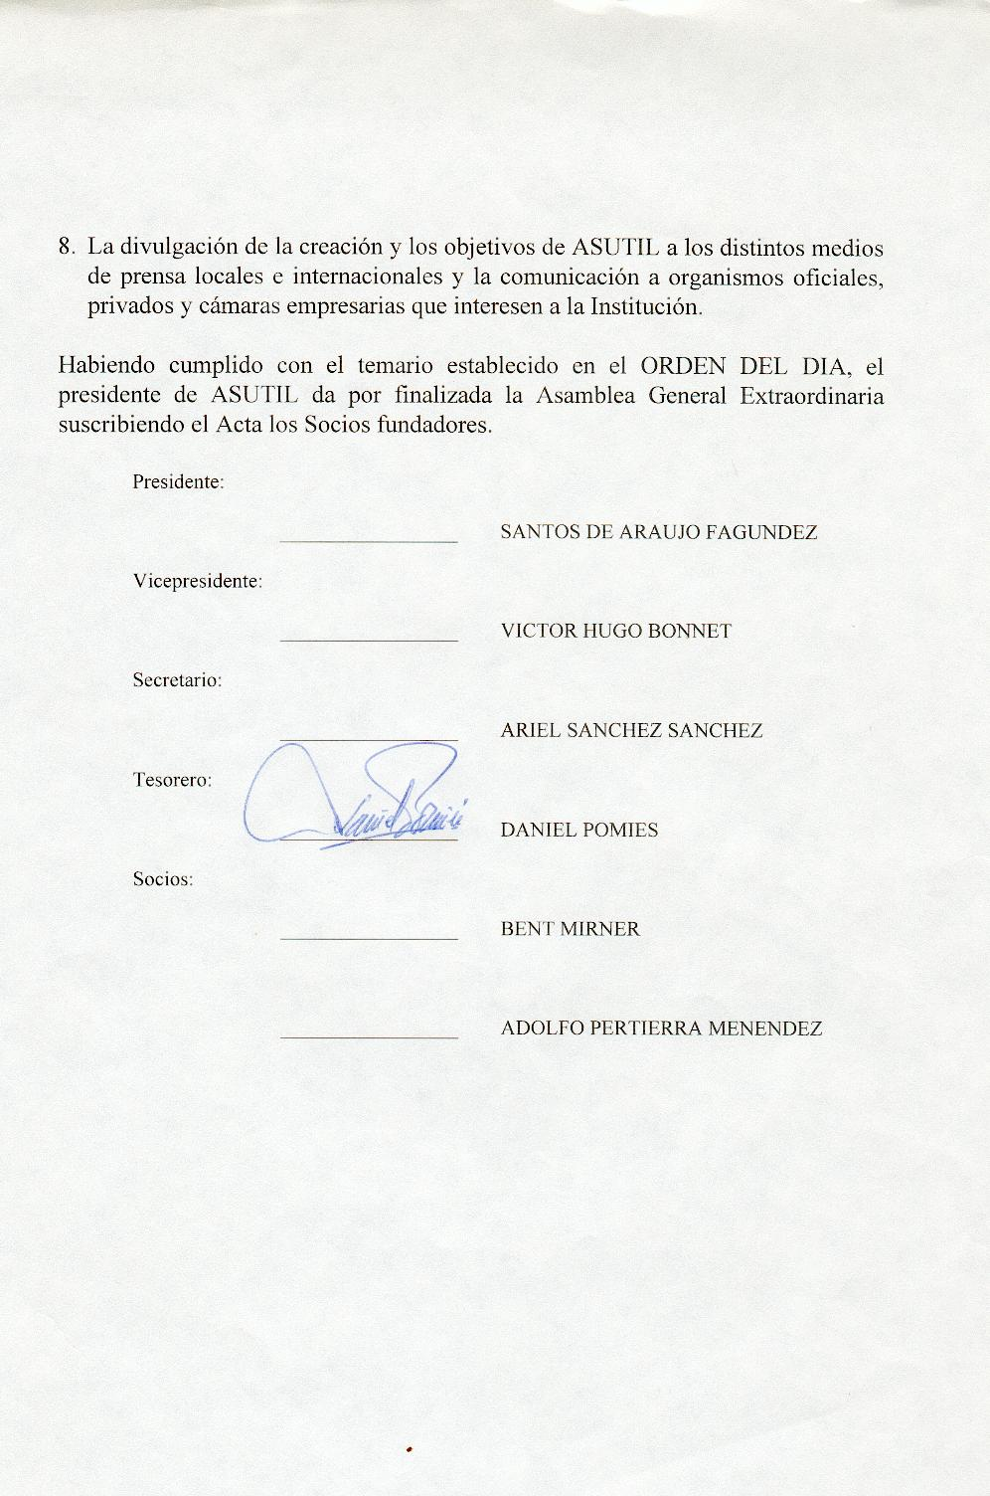
Strengthening THE FUTURE – 4th – 7th JUNE – Mexico 2014
ASAMBLEA EXTRAORDINARIA – BS.AS 1995

Slide 7
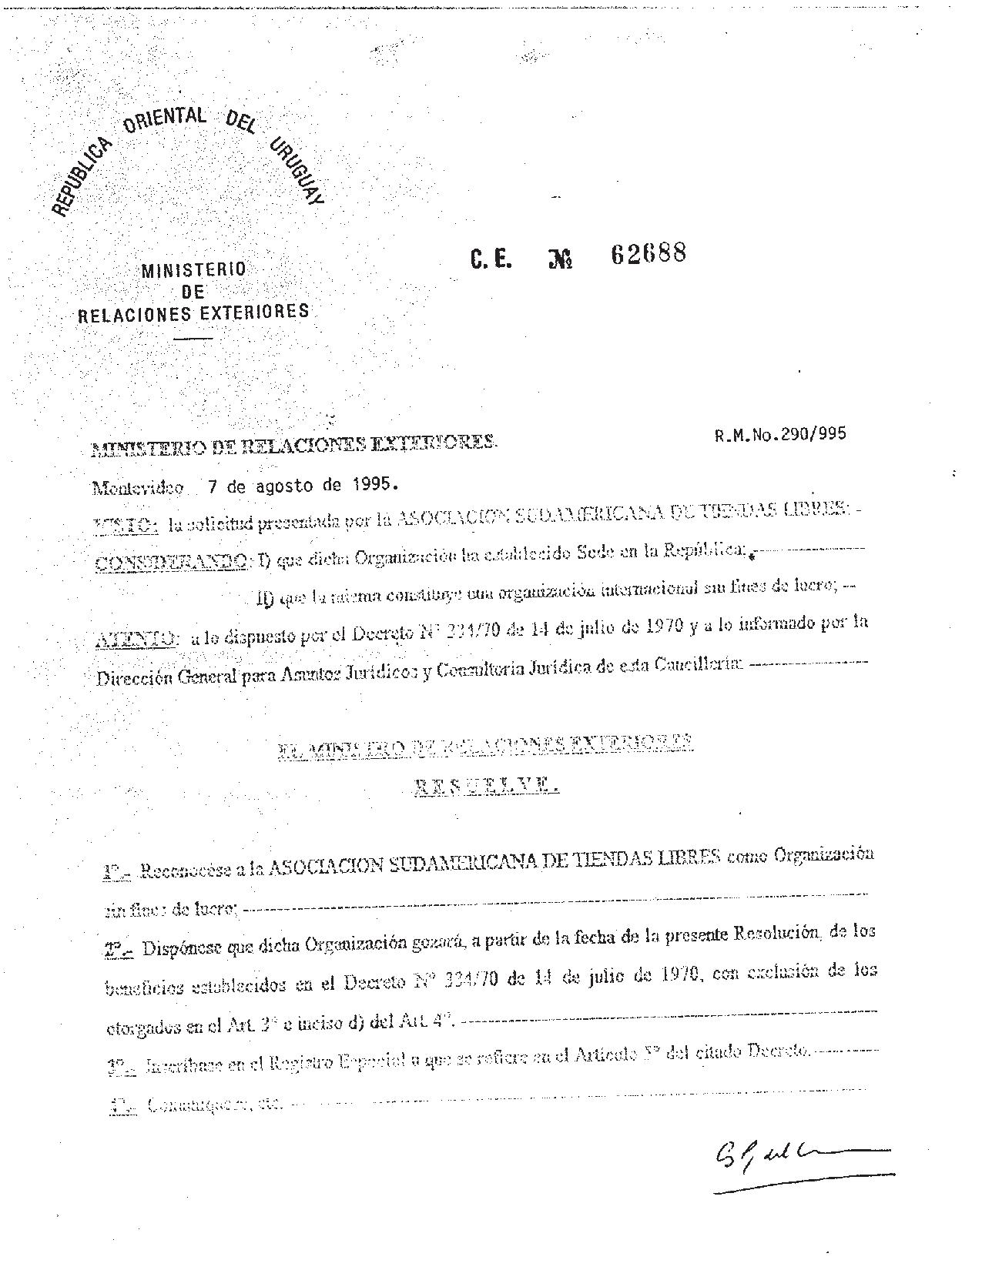
Strengthening THE FUTURE – 4th – 7th JUNE – Mexico 2014
APROBACION DE ASUTIL - 1995

Slide 8

Strengthening THE FUTURE – 4th – 7th JUNE – Mexico 2014
PRIMER LOGO

Slide 9
Strengthening THE FUTURE – 4th – 7th JUNE – Mexico 2014
PRIMEROS ESTUDIOS
Relevamiento del negocio del Duty Free en Sud America
Recopilación normativa y recomendaciones legislativas para incorporar en el Código Aduanero del MERCOSUR y Legislación Chilena

Slide 10
Strengthening THE FUTURE – 4th – 7th JUNE – Mexico 2014
AGRADECIMIENTOS
IAADFS
Dr. Jose Luis Falcao
Dr. Paul Arrigui

Slide 11
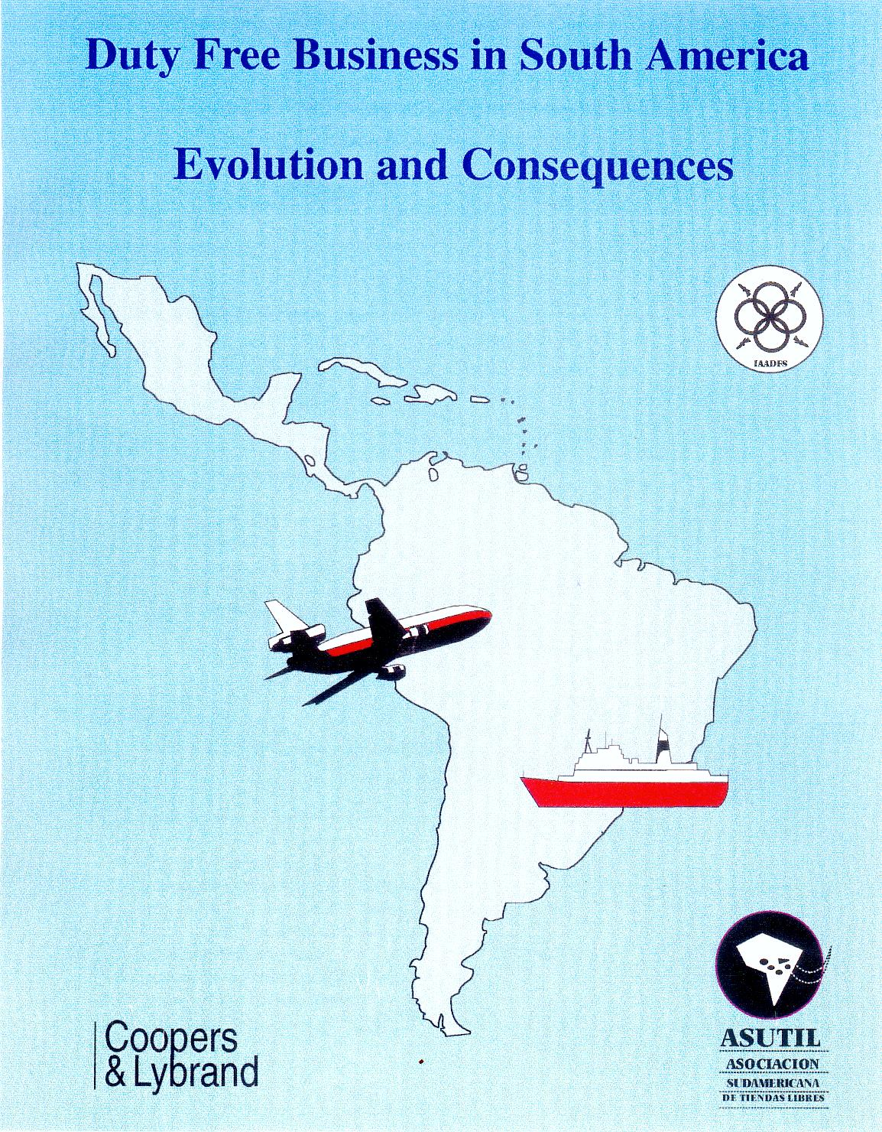
Strengthening THE FUTURE – 4th – 7th JUNE – Mexico 2014
PRIMER ESTUDIO DE LA INDUSTRIA EN SUD AMERICA

Slide 12
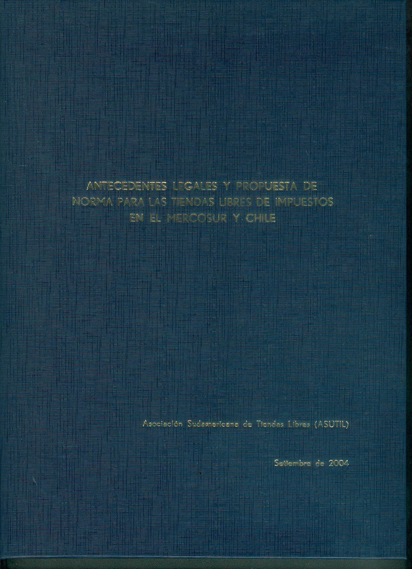
Strengthening THE FUTURE – 4th – 7th JUNE – Mexico 2014
RECOPILACION NORMATIVA Y PROPUESTA PARA EL CODIGO ADUANERO DEL MERCOSUR Y CHILE

Slide 13

Strengthening THE FUTURE – 4th – 7th JUNE – Mexico 2014
NUESTRAS CONFERENCIAS

Slide 14
Strengthening THE FUTURE – 4th – 7th JUNE – Mexico 2014
AGRADECIMIENTOS
Linda Hopkins
Lois & Paul Pasternak
Martin Moodie
Prensa de la Industria

Slide 15


Strengthening THE FUTURE – 4th – 7th JUNE – Mexico 2014
1997 / 1998 – Rio / Bs.As

Slide 16


Strengthening THE FUTURE – 4th – 7th JUNE – Mexico 2014
1999 / 2000 – Punta del Este / Santiago

Slide 17
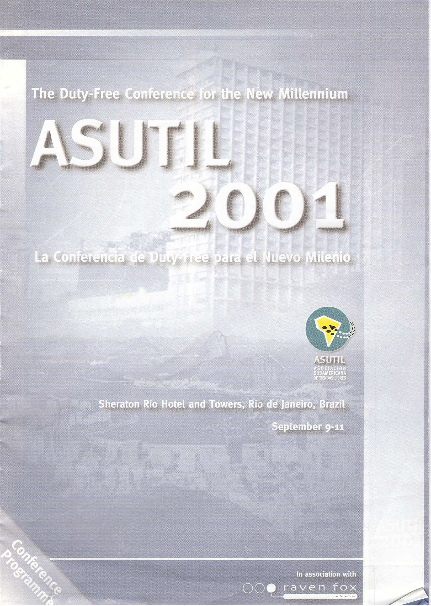
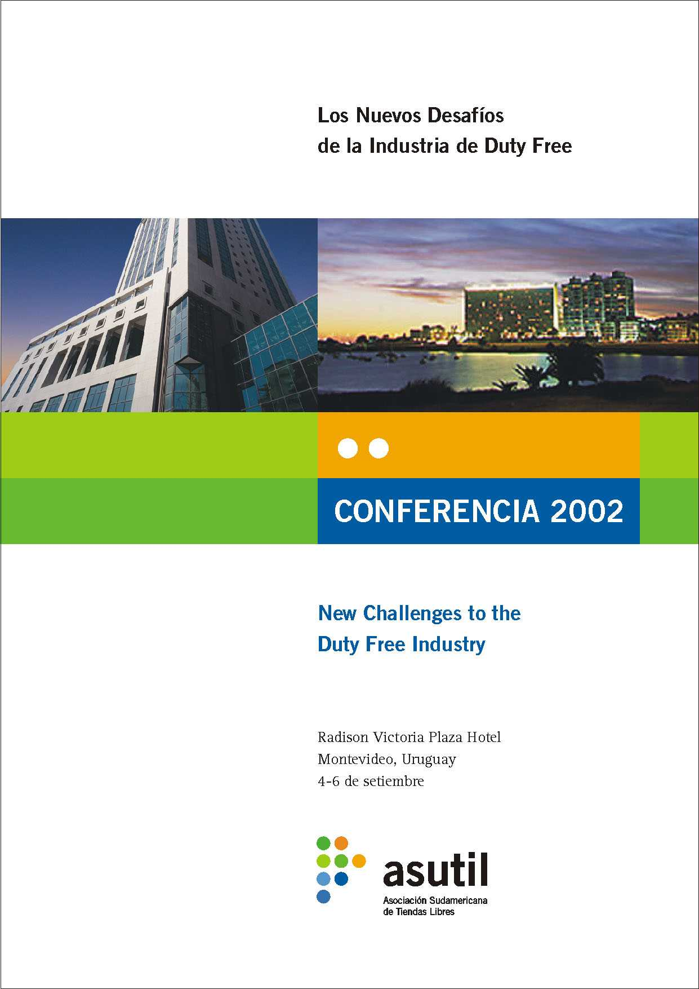
Strengthening THE FUTURE – 4th – 7th JUNE – Mexico 2014
2001 / 2002 – Rio / Montevideo

Slide 18
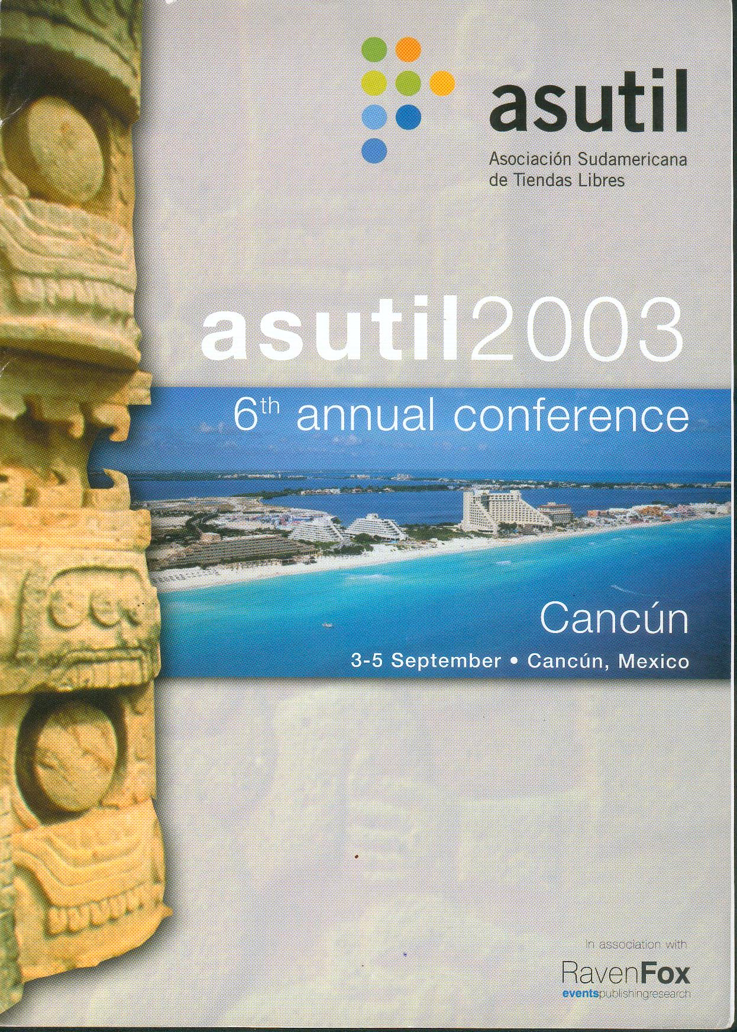

Strengthening THE FUTURE – 4th – 7th JUNE – Mexico 2014
2003 / 2004 – Cancun / Salvador

Slide 19
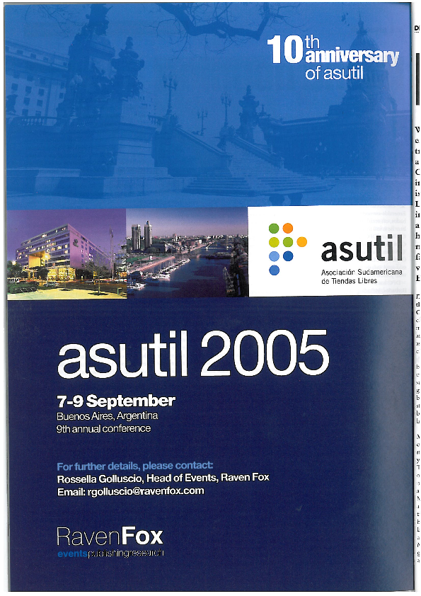

Strengthening THE FUTURE – 4th – 7th JUNE – Mexico 2014
2005 / 2006 – Bs.As / Santiago

Slide 20

Strengthening THE FUTURE – 4th – 7th JUNE – Mexico 2014
2007 / 2008 – Lima / Panamá

Slide 21


Strengthening THE FUTURE – 4th – 7th JUNE – Mexico 2014
2009 / 2010 – Aruba / Puerto Rico

Slide 22


Strengthening THE FUTURE – 4th – 7th JUNE – Mexico 2014
2011 / 2012 – Cancún / Iguazú

Slide 23


Strengthening THE FUTURE – 4th – 7th JUNE – Mexico 2014
2013 /2014 – Punta Cana / México DF

Slide 24

Strengthening THE FUTURE – 4th – 7th JUNE – Mexico 2014
Primera Conferencia de Duty Free de Frontera - 2013

Slide 25

Strengthening THE FUTURE – 4th – 7th JUNE – Mexico 2014
Segunda Conferencia de Duty Free de Frontera – 2014

Slide 26

Strengthening THE FUTURE – 4th – 7th JUNE – Mexico 2014
Socios fundadores

Slide 27
Strengthening THE FUTURE – 4th – 7th JUNE – Mexico 2014
APTRA
ASUTIL
ETRC
FDFA
IAADFS
TFWA
11/3/2014 Primera Reunión Ordinaria en Orlando

Slide 28
Strengthening THE FUTURE – 4th – 7th JUNE – Mexico 2014
Comité Ejecutivo
Franck O’Connell - Presidente
Eric Juul-Mortensen - vicepresidente
Alberto Motta Jr - vicepresidente

Slide 29
Strengthening THE FUTURE – 4th – 7th JUNE – Mexico 2014
Gracias a todos los participantes porque ustedes nos han inspirado a superarnos año tras año para hacer de este evento una fecha ineludible en el calendario de la industria

Slide 30
Strengthening THE FUTURE – 4th – 7th JUNE – Mexico 2014
Agradecimiento muy especial a José Luis Donagaray, Inés Sisto y todo el staff de Asutil que han hecho estas conferencias y el trabajo diario de nuestra asociación posible

